Slide 1
TASK ANALYSIS

Slide 2
“ The Task is at the Heart of HCI “
Two Methods for Task Analysis
1) Human Information Proceser Model
(specially GOMS Model)
2) Cognitive Task Analysis
like : Hierarchical Task Analysis

Slide 3
The GOMS Model
The GOMS model gets it’s name from the four sets of information it Process gathering about a task.
G – Goal
O – Operators
M – Methods
S – Selection Rules

Slide 4
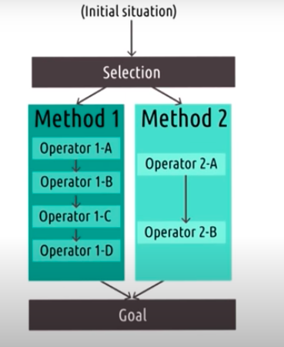
GOMS Model Visualization :

Slide 5


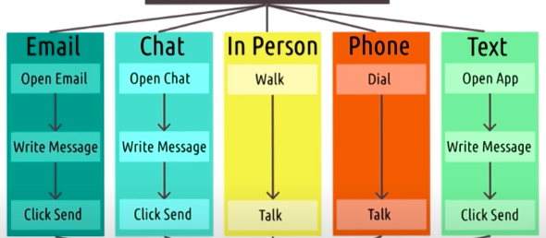

GOMS Model Example

Slide 6
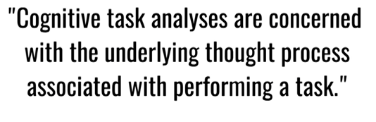
Cognitive Task Analysis

Slide 7
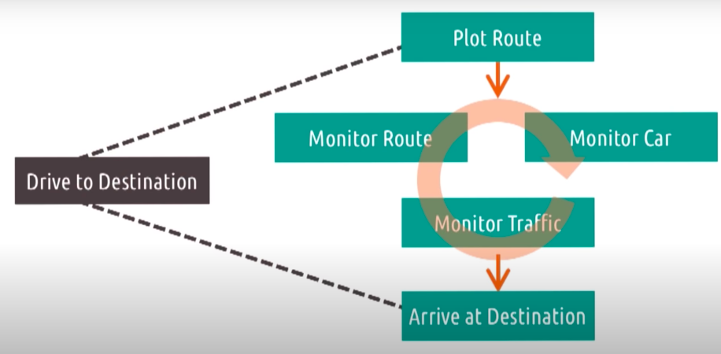
Cognitive Task Analysis : Model of Driving

Slide 8
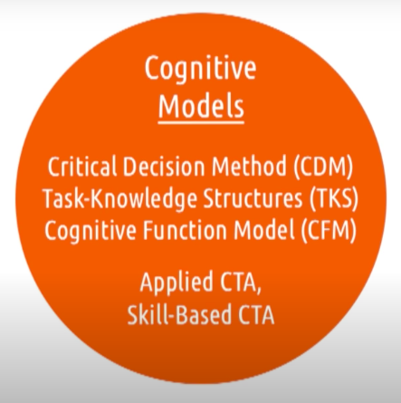

Slide 9
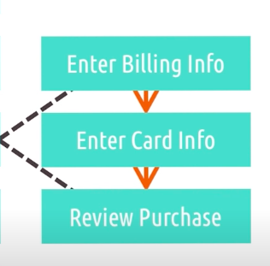
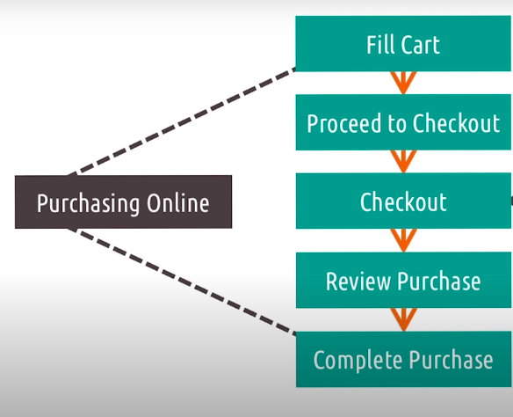
Hierarchical Task Analysis

